Slide 1
Tourism Management System
Courses: Database Management System(Sessional)
Software Development with JAVA(Sessional)

Slide 2

Tourism Management System
Course Teachers: Md. Shafiul Alam Forhad
Sharmistha Chanda Tista
Md. Mynul Hasan
Md. Atiqul Islam Rizvi
(Assistant Professor, Dept of CSE, CUET)
Presented By: Aditta Saikat (1904121)
Md. Rafsan Bin Ali Usha (1904130)
Wong May Nu (1904132)

Slide 3
Content
Introduction
Motivation
Project Overview
Final Database Design
System Implementation
Conclusion

Slide 4
Introduction
Tourism has increased exponentially with the increase of hustle and bustle in daily work life.
A well planned coordination and cooperation among tourists, tour guides and people related to tourism industry is highly needed.
Most of the youngsters, even middle aged people, are found touring in rocky mountains and waterfalls in the thirst for adventure.
Sometimes tour plans are not even executed due to the lack of enough resources for proper planning.

Slide 5
Introduction
There’s no platform in Bangladesh till date that works on the remote level tourism.
This communication gap between tourists and locals has made the wonders of natures hidden in a veil to the people struggling in the loop of daily workload.
The tourism management system has been created to open a platform that gathers all the tour guides, restaurant managers and joomghar managers in one place.
Tourists have access to all the possible necessary information for their upcoming adventurous tour.

Slide 6
Motivation
The system is motivated from two perspectives:
1. Tourist:
To get rid of unreliable sources, fake news, rumors.
To make an adventurous tour plan easier.
Ease of access to all the necessary information in one source
2. Locals:
Supporting local tourism industry in remote level.
Protecting the authenticity of a locality and its culture.

Slide 7
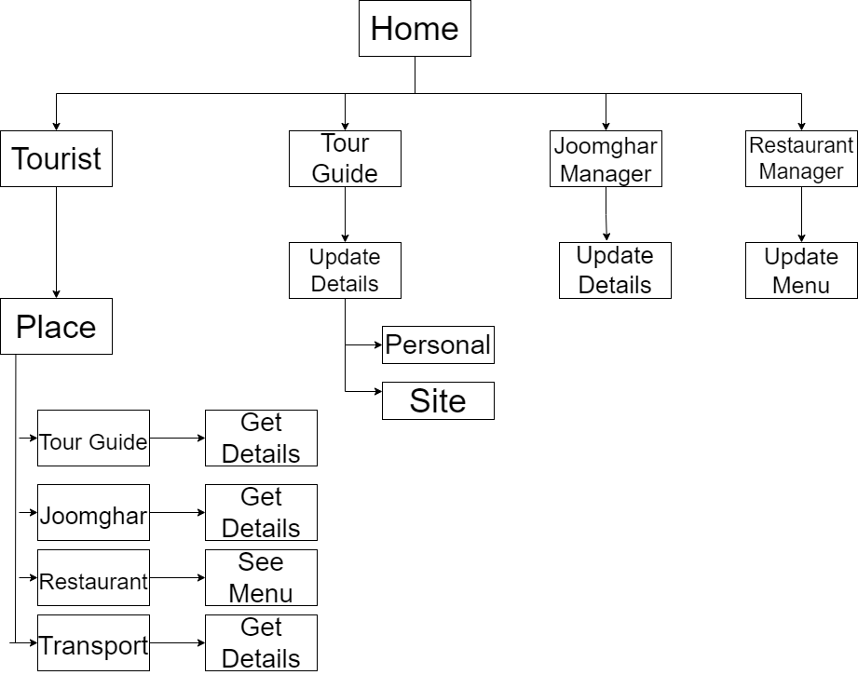
Project Overview

Slide 8
Objectives
This application has been build aiming to-
Provide tourists with a convenient and efficient way to access information.
Streamline the process of finding travel service.
Build a centralised database of information about local travel service.
Improve the visibility and accessibility of local businesses for tourists.
Spread awareness about the remote areas and protect their social diversity.

Slide 9
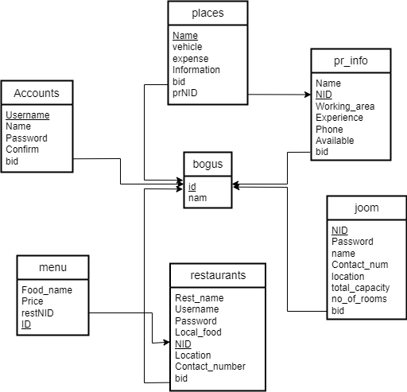
Final Database Design

Slide 10
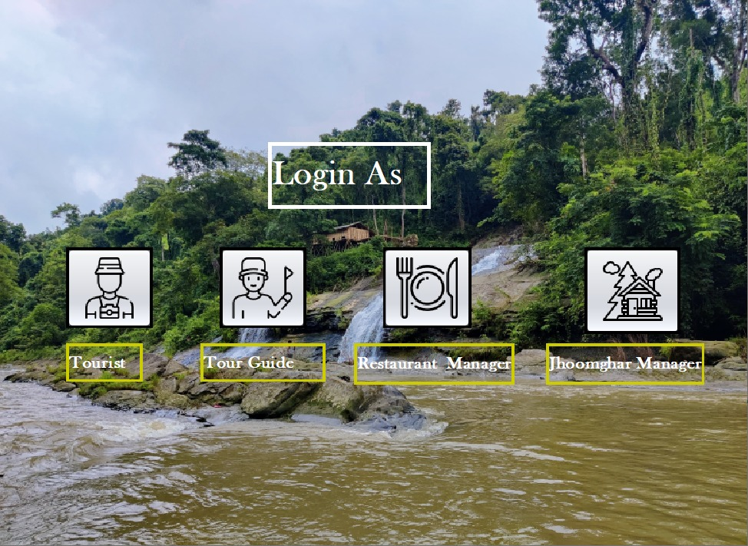
System Implementation
Home Page

Slide 11
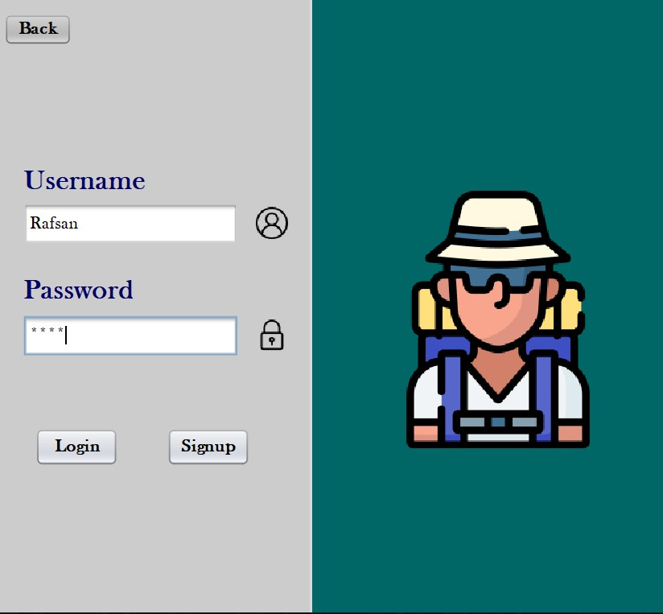
System Implementation
Login as Tourist

Slide 12
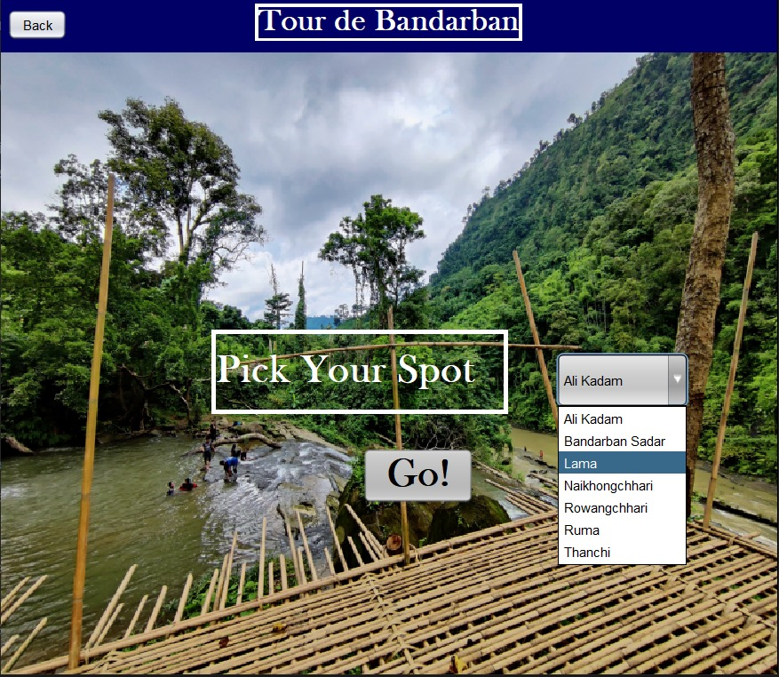
System Implementation
Destination Selection

Slide 13
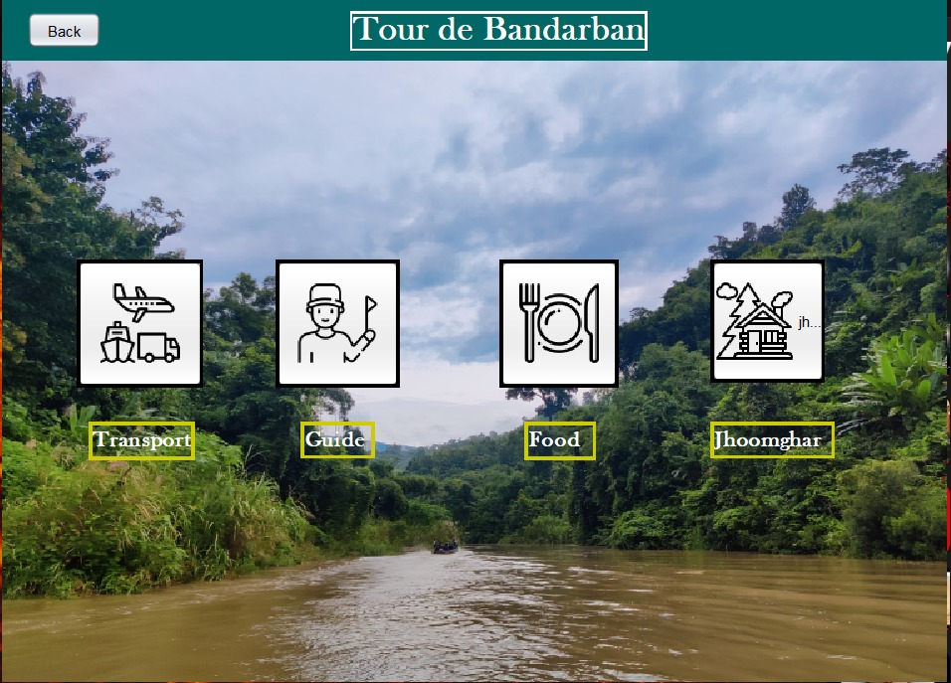
System Implementation
Landing Page for Tourist

Slide 14
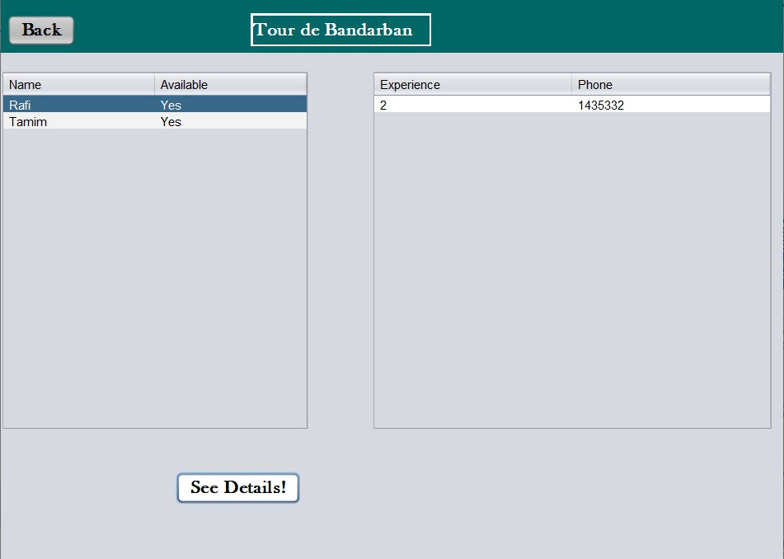
System Implementation
Available Tour Guide List

Slide 15
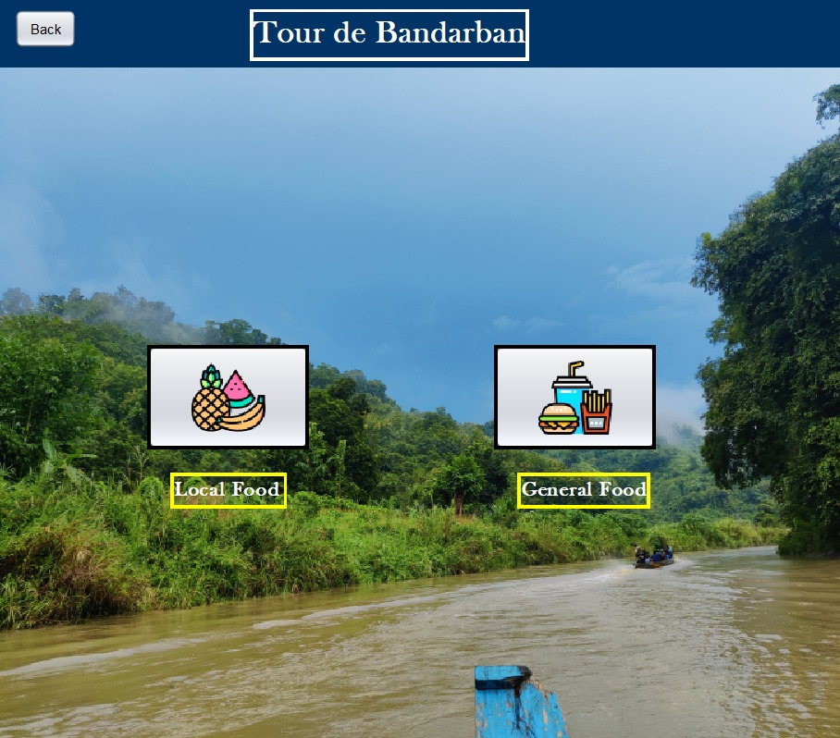
System Implementation
Food Type Selection

Slide 16
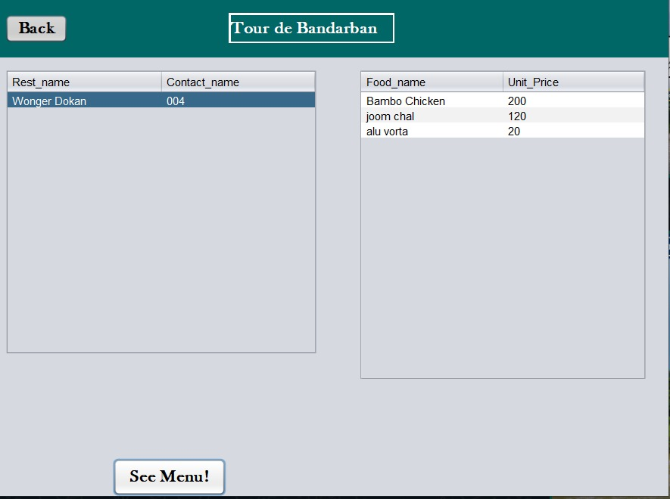
System Implementation
Restaurant Menu

Slide 17
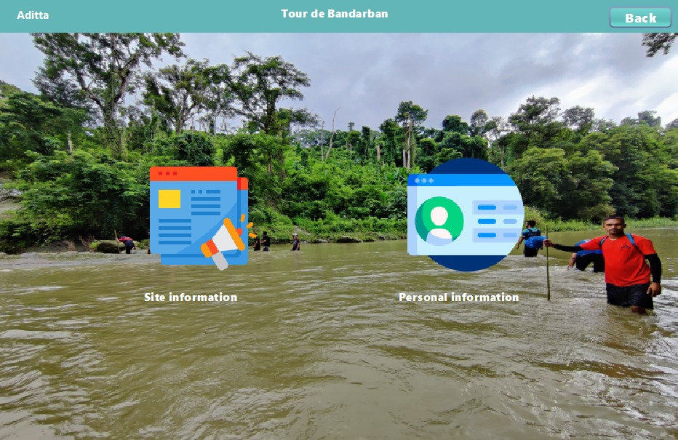
System Implementation
Landing Page for Tour Guide

Slide 18
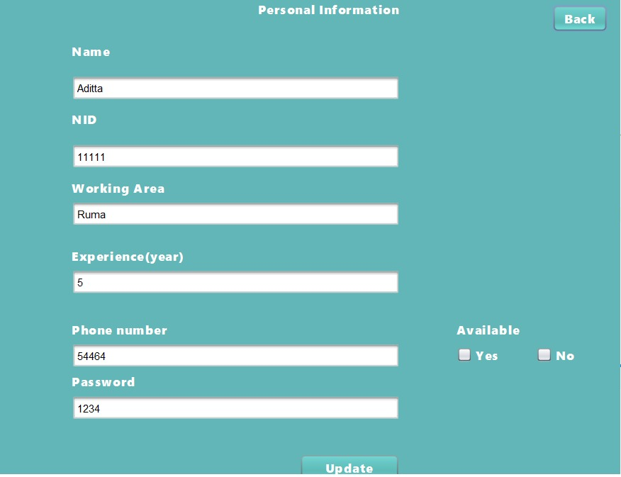
System Implementation
Viewing Personal Details of Tour Guide

Slide 19
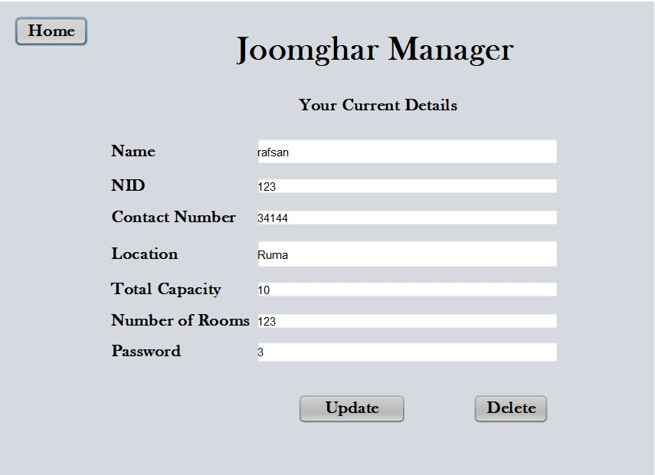
System Implementation
View Details of Joomghar Manager

Slide 20
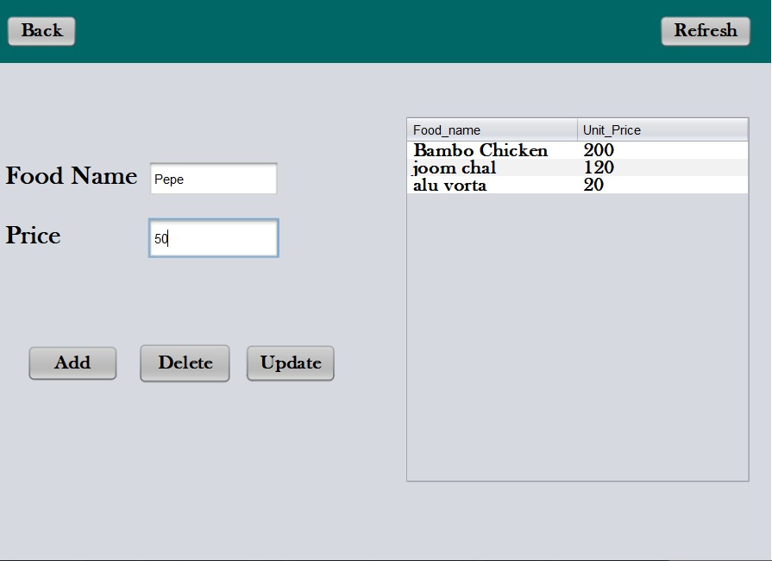
System Implementation
Modify Menu of Restaurant

Slide 21
Conclusion
To conclude, tourism management system has potential to-
Simplify the travel planning process
Enhance the quality of information available to tourists
Boost the growth of the remote level tourism industry
Minimize the communication gap between mainstream and local communities

Slide 22
Thank You!

